Slide 1
INF10025
Data Management and Analytics
Week 03 – Part 3
Importing Data

Slide 2
Importing Data
Data often exists prior to the development of a database.
That data often needs to be entered into the Access database tables.
Option 1 : Retype the data
  Costly
  Prone to Errors
  Slow
Option 2 : Import the data using database tools
  No cost (other than creating the process)
  Fast
  No typing errors
  Same process is applied to every record
  Can apply conversion rules
  Can convert data from one datatype to another

Slide 3
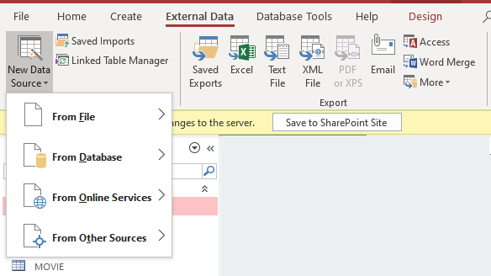
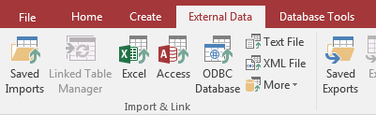
Importing Data
Access can import data from many sources
There are many different source types
Popular types include
  Excel
  Text File
  XML
  Database to Database

Slide 4
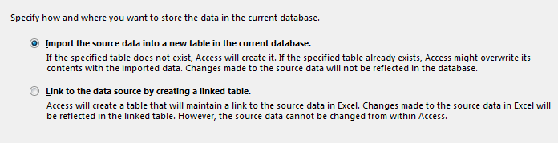
Importing Data
When importing data, you need to determine how you will treat the data
Option 1: Import the data
  Make a copy of the original data.
  The data will be stored in Access Tables.
Option 2: Link to the source data
  There is only one version of the data
  Source Data is maintained by the original application
  Access has a read-only view of the data
Most often used to import data
Used typically when data in Access works in conjunction with data that is continually maintained by another database application.

Slide 5
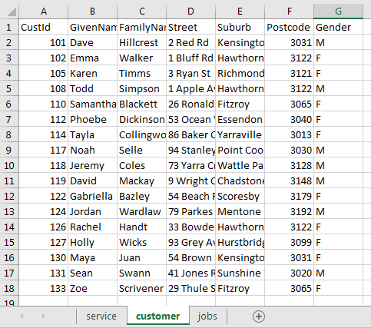
Importing Data from Excel
Rules for importing Excel data.
The data in an Excel spreadsheet must
resemble an Access Datasheet view.
Data has to be placed in
uniform rows and columns.
Data can be located in multiple
worksheets.
Every column must have a heading.

Slide 6
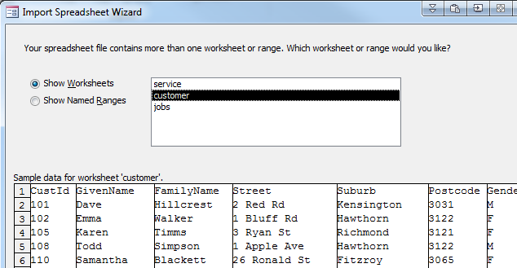
Importing Data from Excel
Access will ask which the worksheet name of where the data is located in

Slide 7
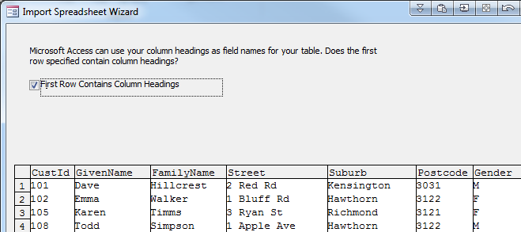
Importing Data from Excel
Specify that the worksheet has Column Heading in row 1.
Otherwise
  Your headings will be treated as field values
  Each field will be given a sequential name such as Field1, Field2, Field3…

Slide 8
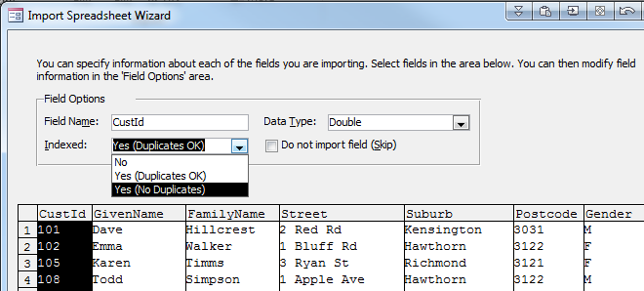
Importing Data from Excel
Specify which fields are Indexed.
The most important field where to specify index requirements is the Primary Key field.

Slide 9
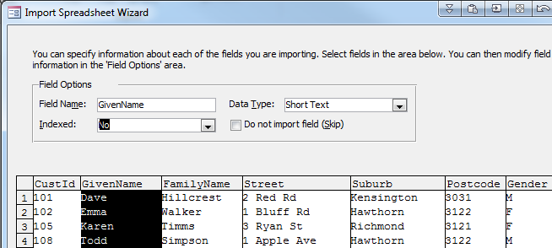
Importing Data from Excel
You can also adjust the name and data type of each field.
Often Text data will need to be converted to a number data type

Slide 10
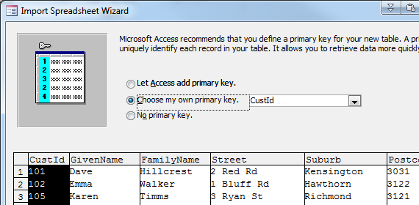
Importing Data from Excel
The final step is to determine the Primary Key
You can allow Access to create an AutoNumber key for you
  This is stored in a new field
Otherwise, select which field already contains Primary Key values

Slide 11
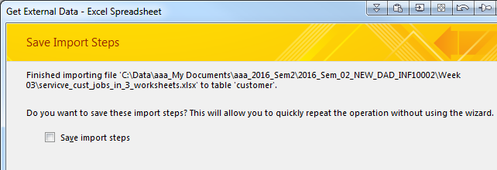
Importing Data from Excel
There is an option to save the Import steps that you just created.
This is useful when:
  You need to import data regularly (every morning, every week …)
  You want someone inexperienced to perform the process
I don't normally save the steps.

Slide 12
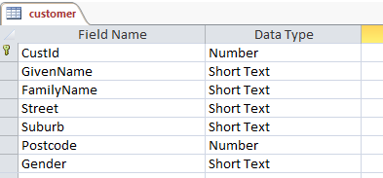
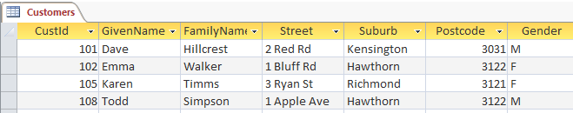
Importing Data from Excel
The data that is successfully imported and saved into a Table.
The table has fields with data types.

Slide 13
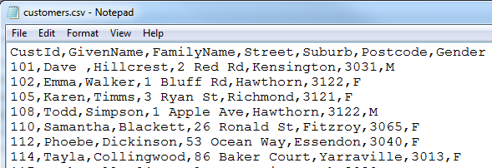
Importing Data from a CSV file
Data is often available in CSV files. CSV stands for Comma Separated Values
This is also sometimes referred to a Delimited File Format, where values are delimited by a character (such as a comma)
Sometimes text-data may be surround by quotes. E.g. 101, "Dave", "Hillcrest", "2 Red Rd"

Slide 14
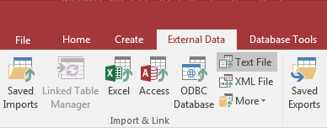
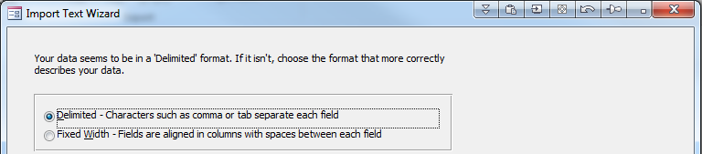
Importing Data from a CSV file
Select the Text File option for CSV files
There are two options for Text files.
  Delimited
  Fixed Width
Choose Delimited for a CSV file

Slide 15
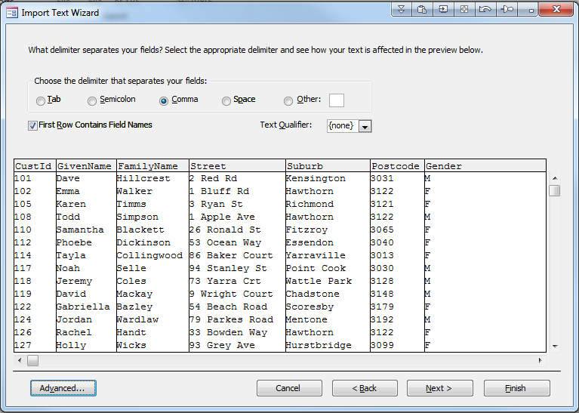
Importing Data from a CSV file
Specify the delimiter character.
  Normally a comma, but it could be another character
Specify that Row 1 contains field names
Specify the text qualifier (e.g. the character surrounding text such as " or ' )

Slide 16
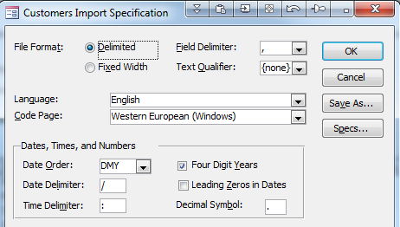
Importing Data from a CSV file
Click on the Advanced button (previous screen) for additional options
These are especially useful when importing dates
These are many commonly used date formats:
Many countries use a comma as a decimal point €123,00:
25/09/2010
09/25/2010
2010/09/25
12-Sep-2010
25-09-2010
09-25-2010
2010-09-25
25/09/10
25/9/2010
2010/9/25
…

Slide 17
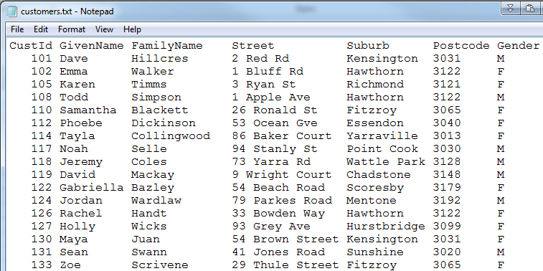
Importing Fixed Width Files
Files are sometimes created as Fixed Width files / Space Delimited files

Slide 18
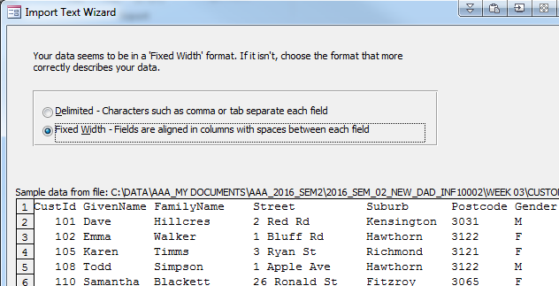
Importing Data
Select the Fixed Width
Option in Access

Slide 19
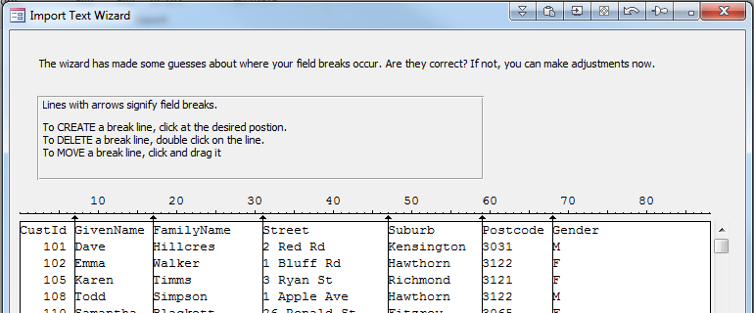
Importing Fixed Width Files
You have to place vertical lines to signify where each field begins.

Slide 20
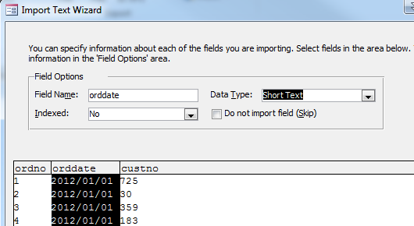
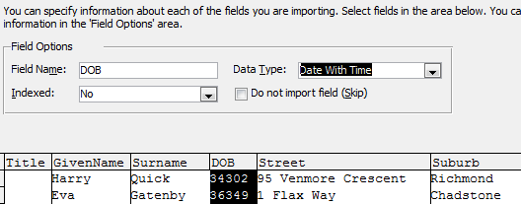
Specifying Field information
When importing data, often Access does not recognize data formats.
Dates are often a problem
As you click on a field, you can modify the Field Name and / or Data Type

Slide 21
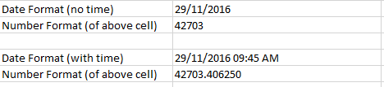
Dates in Excel
You should be aware how Excel stores dates and times
Excel stores dates and times as a sequential number representing the number of days since 1 Jan 1900
The fractional portion of the value stores the time.
This is called a serial date.

Slide 22
Dates in Excel
When you import data from Excel, it may appear that
the values are not dates.
Access will interpret the values correctly

Slide 23
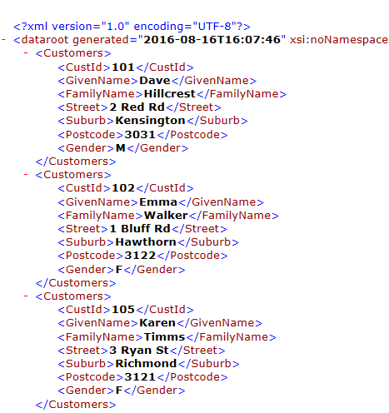
Importing XML files
Access can also import data from
XML files.
Each piece of data is stored between
tag elements
A start tag and an end tag
Tags can have a hierarchy.
This example shows that
the <Customers> tag contains
seven subordinate tags:
<CustId>
<Givenname>
<FamilyName> …

Slide 24
Importance of knowing file formats
An organization typically has
  Many IT systems & Databases
    Accounting systems
    Stock and Inventory systems
    Sales & Ordering systems
    Student Record system
  Data that is exchanged with other organizations
    A list of parts that your organization can order
    A list of VTAC / high-school students that have selected Swinburne University
    in their list of preferred institutions
    A price list
Few (if any) of these systems are integrated.
The only way data can be exchanged is via CSV, Delimited file, Excel file, XML file formats.
Learning how to import / export data via Access in a very useful skill.

